Slide 1

Analysis and Comparison of Parallel Sorting Algorithms
Chen-Kai Tsai, Jing-Chiou Liou
Computer Science, Kean University, tsaiche@kean.edu

Slide 2
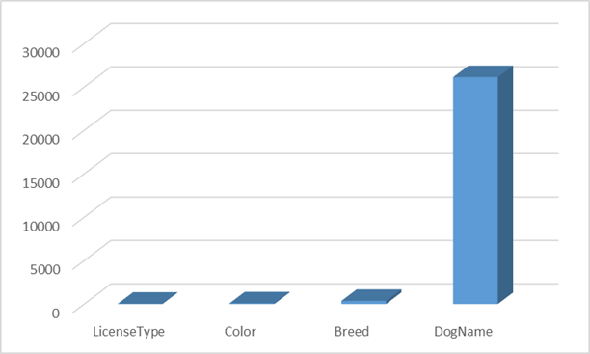
Introduction
Why Parallel?
Sorting Algorithms
Shell Sort
Bitonic Sort
Merge Sort
Rank Sort
Selection Sort
Odd-Even Sort
Test Environment
Operating system: Ubuntu 18.04.4 LTS with POSIX thread model
CPU: Intel Core i7-9750H
Memory size: 32GB
GCC version: 7.4.0 with OpenMP version 4.5
MariaDB version 10.1.44
Test Dataset
Strong Scaling
Weak Scaling
Uniform Dataset
Real-World Data in Database

Slide 3
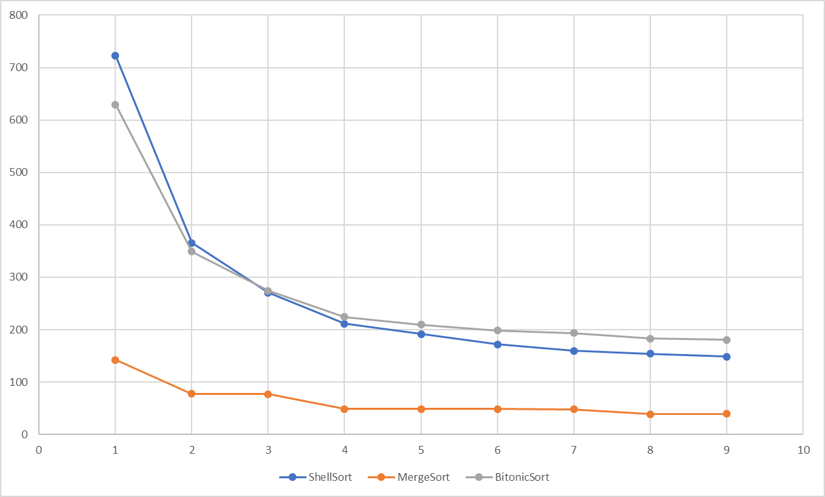
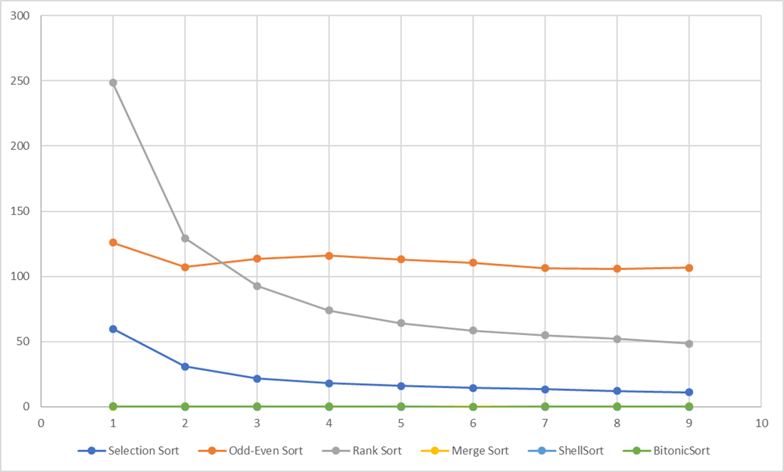
Strong Scaling Tests
Dataset Size: 2GB
Dataset Size: 1MB

Slide 4
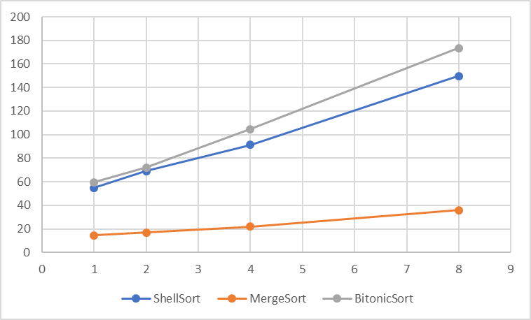
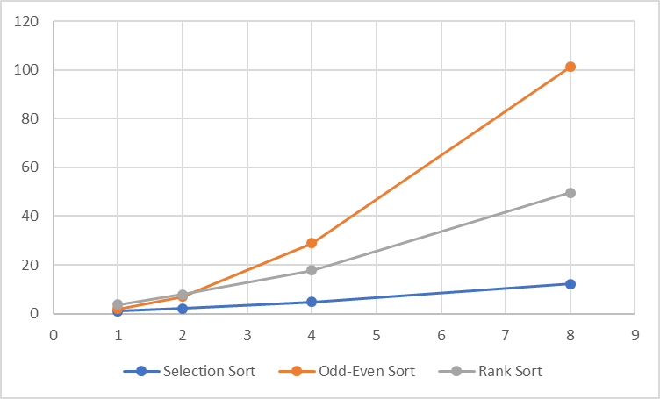
Weak Scaling Tests
Dataset Size: 256MB ~ 2GB
Dataset Size: 128KB ~ 1MB

Slide 5
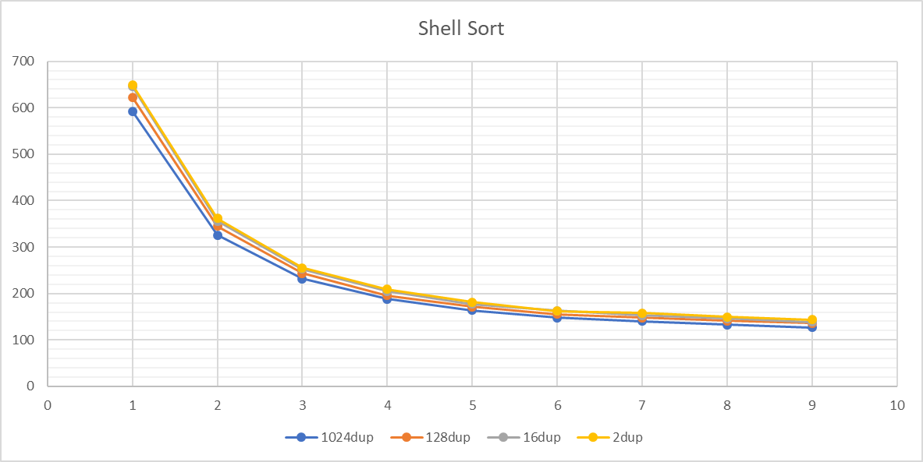
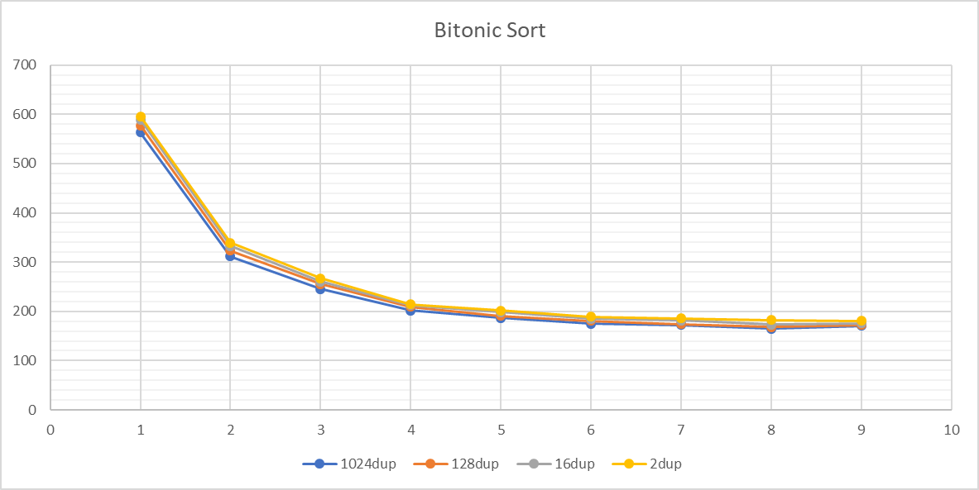
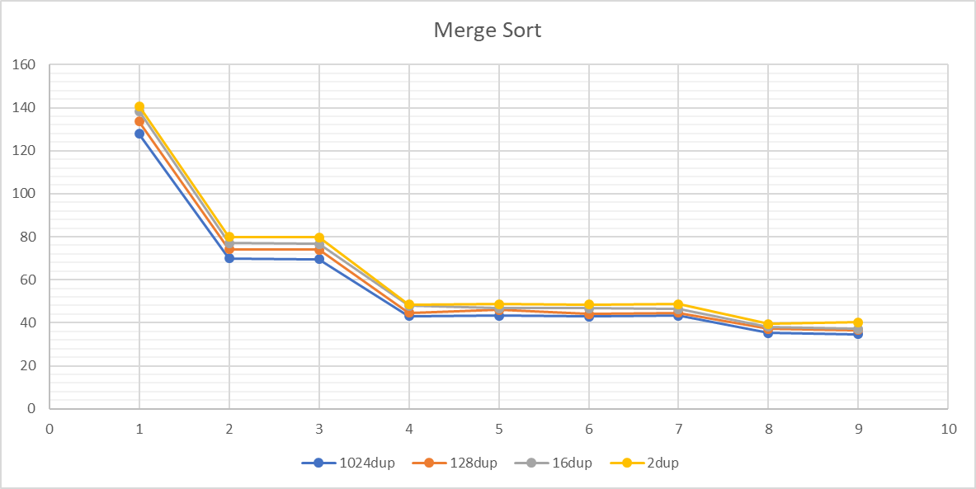
Uniform Dataset Tests
Use 4 cores | Shell Sort | Bitonic Sort | Merge Sort
1024 dup | 188.539s | 201.483s | 43.075s
2 dup | 209.383s | 214.401s | 48.474s

Slide 6
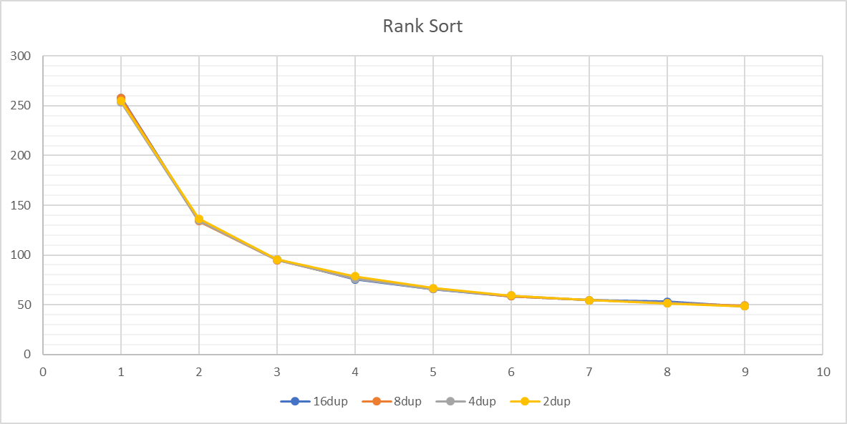
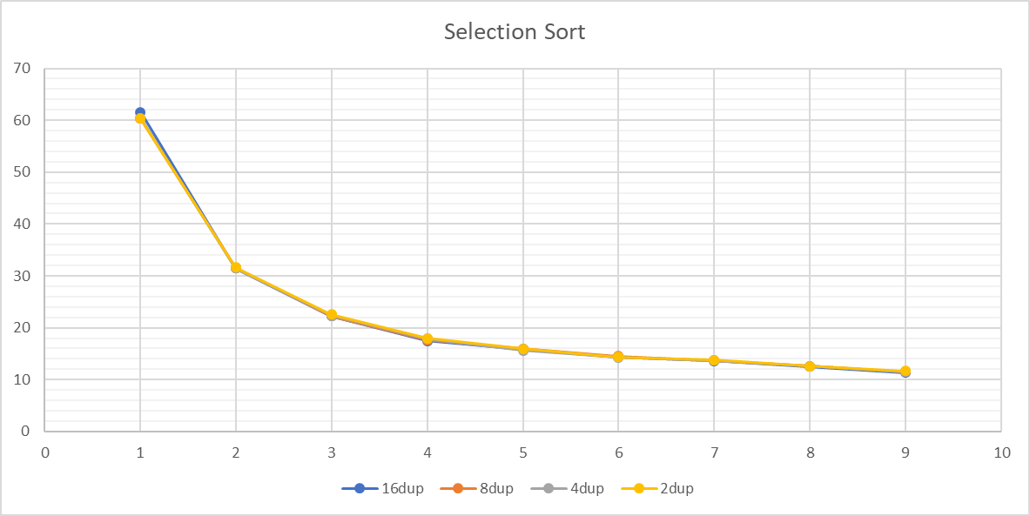
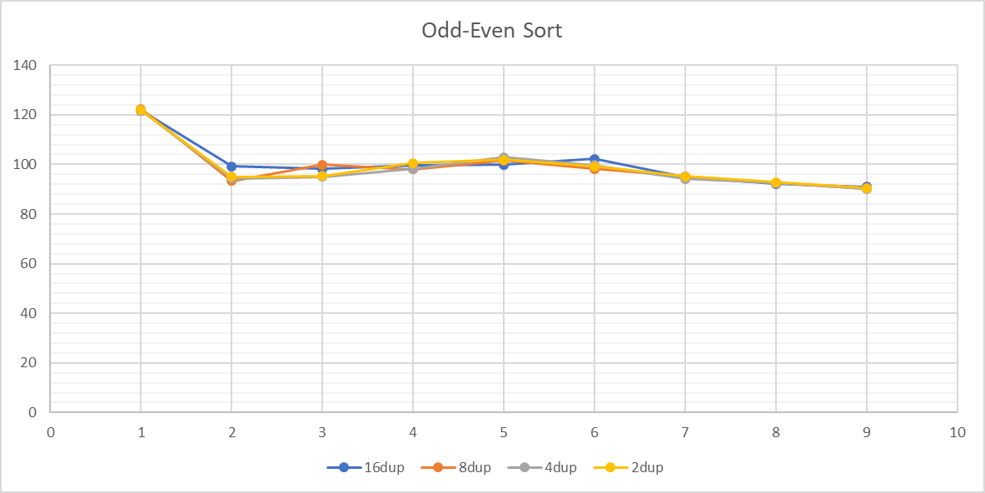
Uniform Dataset Tests
Use 4 cores | Rank Sort | Selection Sort | Odd-Even Sort
16 dup | 75.447s | 17.497s | 201.483s
2 dup | 78.652s | 17.965s | 214.401s

Slide 7
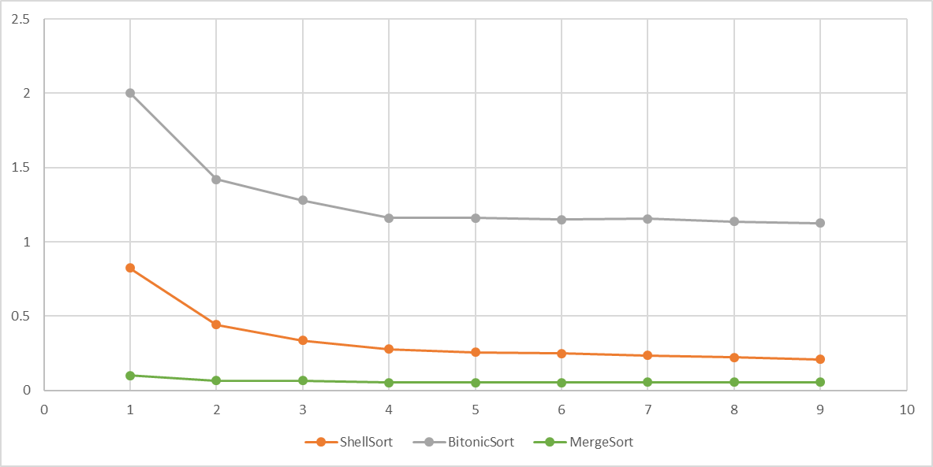
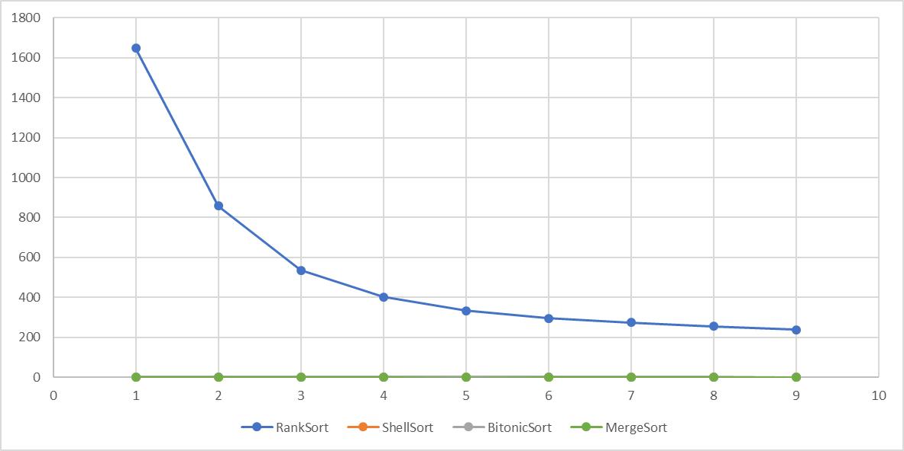
Real-World Data in Database
Query: SELECT LicenseType, Color, Breed, DogName FROM dog_license LIMIT 262144
1MB and with 16 dup | Shell Sort | Bitonic Sort | Merge Sort | Rank Sort
Swapping | 8014788 | 10517003 | N/A | 262144
Comparison | 11904223 | 40370175 | 4387071 | 68721838126

Slide 8
Conclusion
Merge Sort has the Best Performance
It has best sequential complexity. However, it need extra space for merge.
Parallel Version of Sorting Algorithm’s Performance Depends on Its Sequential Performance
The performance of parallel version sorting algorithms are heavily affected by their sequential performance.
Weak Scaling Performance Tests can be Tuned
We can tune the ratio between the dataset size and the computational resource to help decide assigned hardware resource for certain data size.
The Influence of Duplicated Elements in Dataset
In our tests, there is no certain performance of a sorting algorithm surpass others because of this factor.
The Number of Comparison Operations has Most Influence When Sorting Text in Database
String comparison operations are more expensive than the swapping operation. Therefore, algorithm with less comparison will have better performance.

Slide 9
Reference
Darko Božidar and Tomaž Dobravec. Comparison of parallel sorting algorithms. Technical report November 2015
Clay Breshears. The Art of Concurrency May 2009: First Edition. ISBN: 978-0-596-52153-0
Henrik Swahn Faculty of Computing Blekinge Institute of Technology SE-371 79 Karlskrona Sweden. Pthreads and OpenMP A performance and productivity study
OpenMP Website: https://www.openmp.org/
Knuth, Donald E. (1997). "Shell's method". The Art of Computer Programming. Volume 3: Sorting and Searching (2nd ed.). Reading, Massachusetts: Addison-Wesley. pp. 83–95. ISBN 978-0-201-89685-5.
Shell, D. L. (1959). "A High-Speed Sorting Procedure" (PDF). Communications of the ACM. 2 (7): 30–32. doi:10.1145/368370.368387
K. E. BATCHER Goodyear Aerospace Corporation Akron, Ohio. Sorting networks and their applications
Jayshree Ghorpade, Jitendra Parande, Madhura Kulkarni, Amit Bawaskar GPGPU PROCESSING IN CUDA ARCHITECTURE Advanced Computing: An International Journal ( ACIJ ), Vol.3, No.1, January 2012
Ayushi Sinha, Supervisor: Prof. Kunal Agrawal Sorting on CUDA August 20, 2010
Dmitri I. Arkhipov, Di Wu, Keqin Li, and Amelia C. Regan Sorting with GPUs: A Survey September 8 ,2017
OpenMP Architecture Review Board OpenMP Application Programming Interface
Dominik Żurek, Marcin Pietroń, Maciej Wielgosz, Kazimierz Wiatr THE COMPARISONOF PARALLEL SORTING ALGORITHMSIMPLEMENTED ONDIFFERENT HARDWARE PLATFORMS 2013

